Slide 1
RA 505 Robot Sensing and Vision Lecture 25
Dr. Rishikesh Kulkarni
Department of Electronics and Electrical Engineering
IIT Guwahati

Slide 2
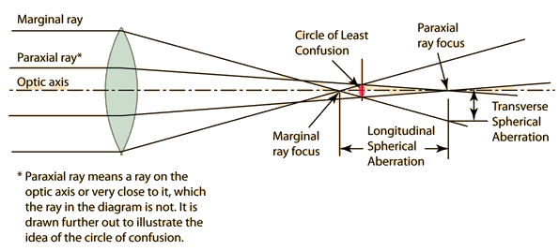
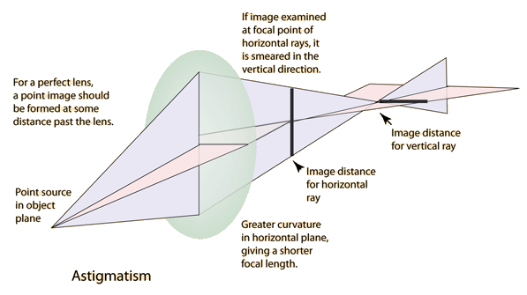
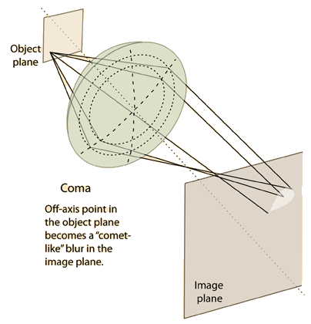
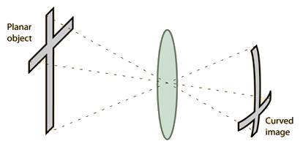
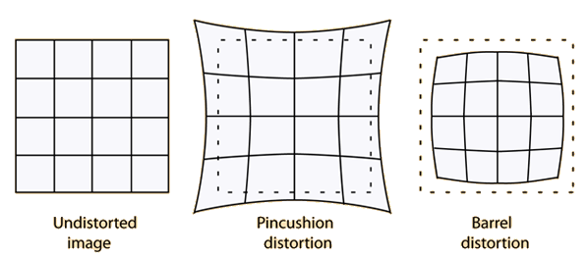
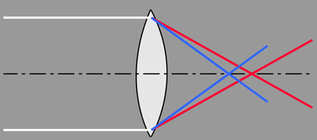
Aberration
Spherical aberration
Comatic
Astigmatism
Curvature of field
Distortion
Axial or longitudinal chromatic aberration

Slide 3


Slide 4
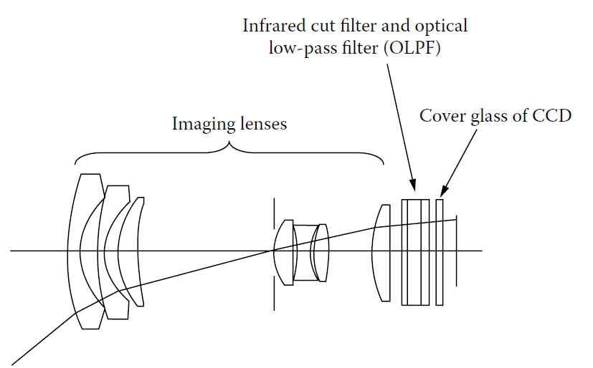
Imaging Optics
Imaging lenses, an infrared cut filter, and an optical low-pass filter (OLPF)
Imaging lenses: zoom lenses, combination of multiple lens
Infrared cut filters: cut out unwanted infrared light; to avoid highly sensitive of imaging element to respond to unwanted infrared light

Slide 5
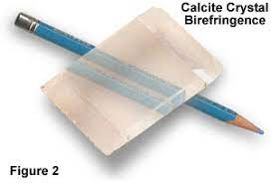
Depth of field and Depth of focus
Optical low-pass filter
Depth of field = 2u²Fc/f²
u= distant to object
f = focal length
F = F-number
c = circle of least confusion
Depth of focus = 2Fc
Circle of least confusion : 2 to 2.5 units of pixel pitch
Thin, birefringent plates made from liquid crystal or lithium niobate
Diffractive optical elements or special aspherical surfaces
different refractive indexes depending on the direction in which light is polarized
Birefringent material is a single material with two refractive indexes.
used to mitigate the moiré effect caused by the interaction of patterns in the object and the pattern on the imaging element caused by the arrangement of imaging element pixels at a fixed pitch

Slide 6
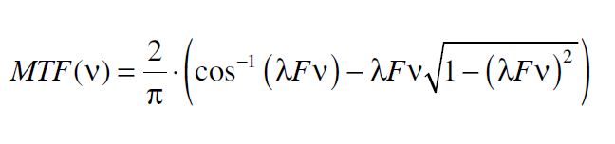

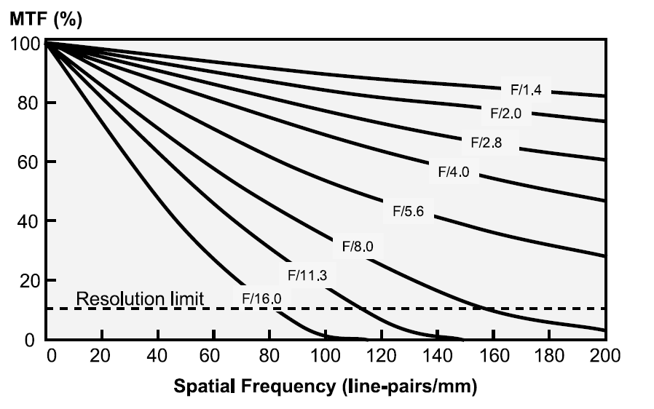
Effect of diffraction
587.56 nm
Pixel pitch at the scale of wavelength
Airy disc
helium d-line (587.56 nm)

Slide 7
Basics of Image Sensors
Imager: solid-state image sensor
Wide spectral range; focus on visible range (380 nm – 780 nm)
Silicon: suitable for visible image sensors
Number of picture elements: Pixels; converts lights into holes/electrons
Charged-coupled device (CCD) image sensor
Complementary metal-oxide semiconductor (CMOS) image sensor
High quality image: high resolution, high sensitivity, a wide dynamic range, good linearity for color processing, and very low noise

Slide 8
Functions of Image Sensors
Photoconversion
Silicon band gap energy: 1.1 eV => wavelengths shorter than 1100 nm is absorbed and photon-to-signal charge conversion takes place
Number of photons absorbed in a region with thickness dx is proportional to the intensity of the photon flux φ(x); x: the distance from the semiconductor surface
photon flux decays exponentially with the distance from the surface; penetration depth (1/α)

Slide 9
Charge collection and Accumulation
Photodiode
Metal-oxide semiconductor (MOS) diode
Charge transfer
accumulated charge or the corresponding signal voltage or current must be read out from a pixel in an image sensor chip to the outside world
Scanning: two-dimensional signal transformation into time-sequenced signal (charge transfer, X-Y addressing)

Slide 10
Interlaced Scan and Progressive Scan

Slide 11
Charge Detection and conversion gain
Potential well is monitored by the voltage buffer
Capacitance C_{FD} acts as a charge-to-voltage conversion
capacitance
Conversion gain
Change in voltage obtained by 1 electron at the
charging node

Slide 12
Photodetector in a pixel
Fill factor = (A_{ps} / A_{pix}) x 100 %
the portion of the pixel covered with the light shield includes the area that holds a transfer gate, a channel stop region that isolates pixels, and a V-CCD shift register
active-pixel CMOS image sensors: at least three transistors (a reset transistor, a source follower transistor, and a row select transistor) are covered by light shield
Color filter array
on-chip color filter array (CFA)
RGB CFAs: superior color reproduction and higher color signal-to-noise ratio
luminance differences are associated with green whereas color perception is associated with red and blue
CMY CFAs: cyan, magenta, and yellow
Materials: pigment type and dye type

Slide 13
Photodetector in a pixel
Microlens array
On-chip microlens array(OMA)
Collimates light to the photodiode
color filter layer-> transparent resin
photolithographic patterning
Increase in sensitivity
Shading effect
Reduce smear in CCD image sensors and crosstalk between pixels caused by minority carrier diffusion
Reflection at SiO2 and Si interface
Refractive index variation causes reflection
more than 20 to 30% of the incident light is reflected at the silicon surface in the visible light range
Anti-reflective films formed above the photodiode

Slide 14
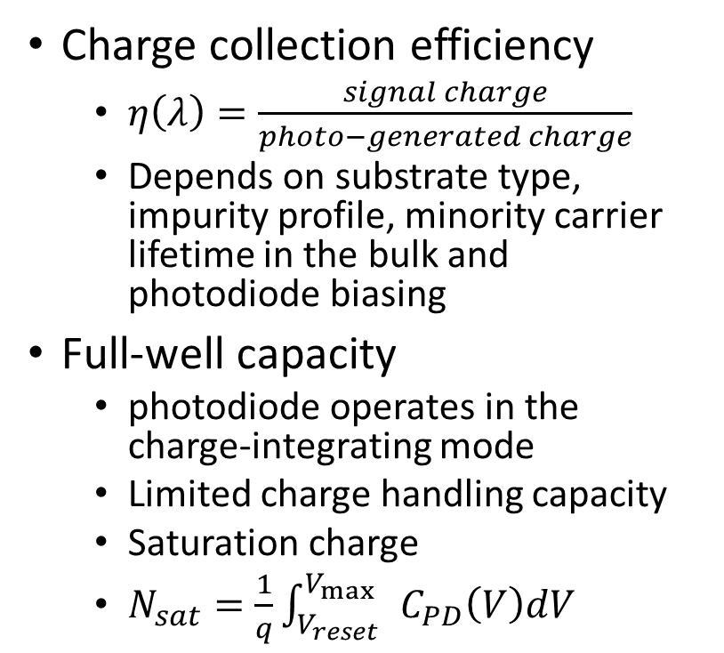
Photodetector in a pixel
Charge collection efficiency
$η\left(λ\right)=\frac{signal charge}{photo−generated charge}$
Depends on substrate type, impurity profile, minority carrier lifetime in the bulk and photodiode biasing
Full-well capacity
photodiode operates in the charge-integrating mode
Limited charge handling capacity
Saturation charge
$N_{sat}=\frac{1}{q}\int_{V_{reset}}^{V_{\max{ }} }{C_{PD}\left(V\right)dV}$

